Slide 1
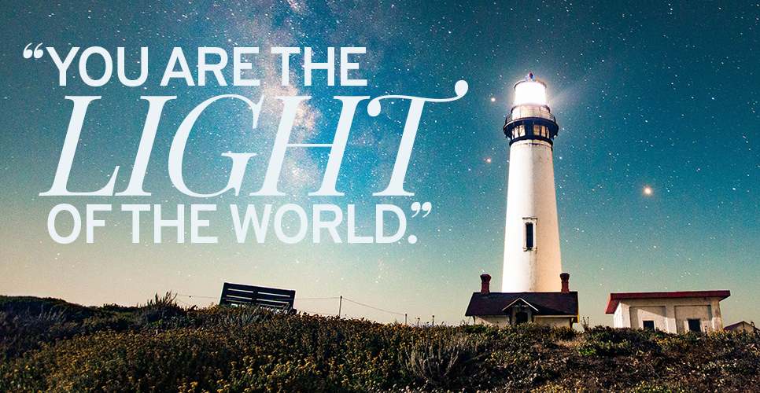
Matthew 5:14-16
Pastor Rod Lago

Slide 2


Slide 3



Slide 4
What did Jesus mean to us when He said, that we are the Light of this darkened and fallen world?

Slide 5
I. God is the Creator and Ultimate Source of All Creation.

Slide 6

He is the Light and the Source of All Lights.
Genesis 1:3-4 New King James Version (NKJV)
3 Then God said, “Let there be light”; and there was light. 4 And God saw the light, that it was good; and God divided the light from the darkness.

Slide 7
B. The Purpose of Light.
To Give Life to Everyone
John 1:3-4 New King James Version (NKJV)
3 All things were made through Him, and without Him nothing was made that was made. 4 In Him was life, and the life was the light of men.

Slide 8
2. To Balance our Eco System
When there is no lights all creations will die.

Slide 9
3. To Expose and Reveal the True Nature of Darkness.
John 1:5 New King James Version (NKJV)
5 And the light shines in the darkness, and the darkness did not [a]comprehend it.
John 10:10 New King James Version (NKJV)
10 The thief does not come except to steal, and to kill, and to destroy. I have come that they may have life, and that they may have it more abundantly.

Slide 10

A. The True Nature of Darkness
To steal, To kill, To Destroy, To lie
B. The True Nature of Light
To Give Life and Life Abundantly

Slide 11
LIFE APPLICATION:
Lagi nating hanapin ang ating mga Liwanag sa piling ng Diyos dahil ang Liwanag Niya ay hindi nauubos para tayong lahat ay maging Liwanag ng mundong ito.

Slide 12
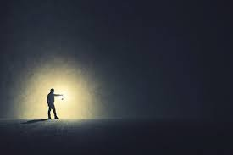
II. WE are God’s Instrument
to be the Light of this fallen world.

Slide 13

a. Stand Up for JESUS.

Slide 14
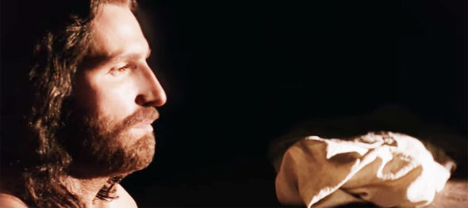
b. Shine for JESUS.

Slide 15

c. Never get tired in doing Good things for JESUS.

Slide 16
LIFE APPLICATION:
They Stand Up for Jesus, even in the midst of all life challenges.
They Shine for Jesus, even though this world are dying and full compromising.
They never get tired in doing and sharing good things to others because they know that in the proper time of God they will reap their rewards.

Slide 17

III. God has All the Power and Authority to Turn all My Darkness into His Marvelous Light.

Slide 18
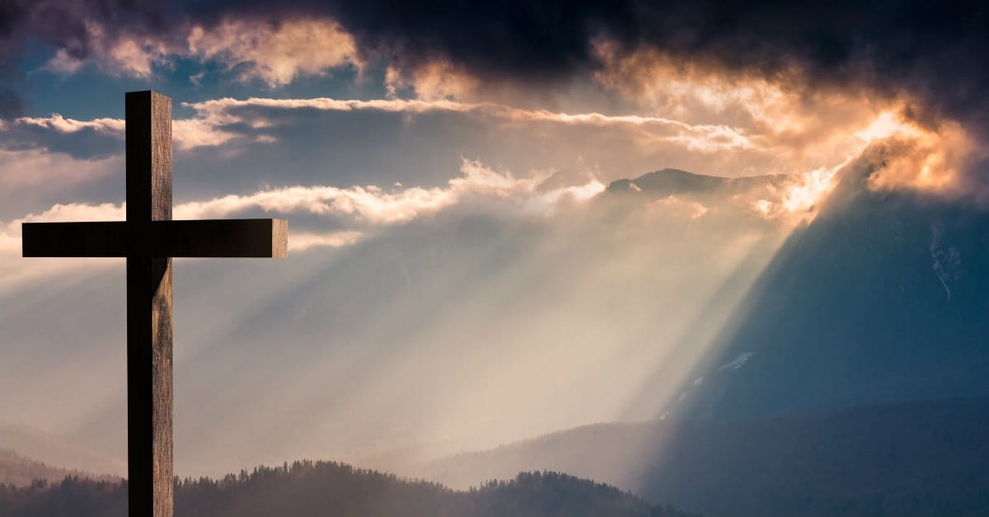
1 Samuel 17:34-37 New King James Version (NKJV)
34 But David said to Saul, “Your servant used to keep his father’s sheep, and when a lion or a bear came and took a lamb out of the flock, 35 I went out after it and struck it, and delivered the lamb from its mouth; and when it arose against me, I caught it by its beard, and struck and killed it.

Slide 19
36 Your servant has killed both lion and bear; and this uncircumcised Philistine will be like one of them, seeing he has defied the armies of the living God.” 37 Moreover David said, “The Lord, who delivered me from the paw of the lion and from the paw of the bear, He will deliver me from the hand of this Philistine.”
And Saul said to David, “Go, and the Lord be with you!”

Slide 20

2 Samuel 22:47-51 New King James Version (NKJV)
47 “The Lord lives! Blessed be my Rock! Let God be exalted, The Rock of my salvation! 48 It is God who avenges me, And subdues the peoples under me;
49 He delivers me from my enemies. You also lift me up above those who rise against me; You have delivered me from the violent man.

Slide 21
50 Therefore I will give thanks to You, O Lord, among the Gentiles, And sing praises to Your name.
51 “He is the tower of salvation to His king, And shows mercy to His anointed,
To David and his descendants forevermore.”

Slide 22
Psalm 27:1 New King James Version (NKJV)
The Lord is my light and my salvation; Whom shall I fear?
The Lord is the strength of my life; Of whom shall I be afraid?

Slide 23
LIFE APPLICATION:
God can turn our Oppositions to our Opportunities.
God can turn our Curses into our Blessings.
God can turn our Failures to our Victories.
God can turn our Sadness into His Gladness.
God can turn our Darkness into His Marvelous Light.

Slide 24
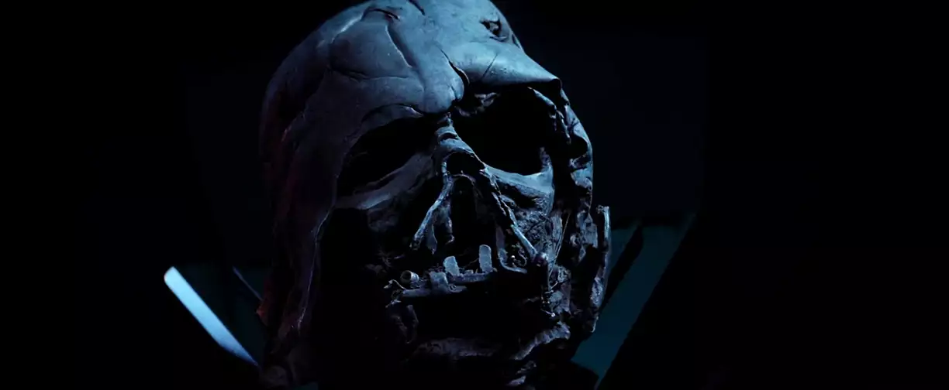

Slide 25
CONCLUSION :
BE THELIGHT OF THIS WORLD. ALWAYS WEAR YOUR LIGHT WHEREVER YOU GO AND SHINE IN THIS DARKEN AND FALLEN WORLD. SO THAT OUR FATHER WHO'S IN HEAVEN WILL BE GLORIFIED!

